Slide 1
Agenda
Course feedback
Probabilistic Surrogate Models
Surrogate Optimization

Slide 2
Course Feedback
23 responses / 85 students
Least happy with pace, most happy with book and organization
Seemed happy with midterm and programming project

Slide 3
Things to Maintain
Assignments have very clear guidelines
The explanations in lecture, late days, and extra credit on the exams have been very helpful
Instruction is excellent, and I appreciate the scope of the class—introduction to a whole bunch of optimization techniques so we know what's out there and the basics of how to implement.
The textbook! Fantastic. Thanks, Mykel! :) Tons of office hours. Super useful.
I really lectures and the applications and the passion this is taught with.

Slide 4
Things to Maintain
The pace of the class is spot on. I feel like we are covering a lot of the material and I'm surprised at how we have not yet fallen behind on lecture material vs. what's needed for assignments.
Mykel comes off as the most caring professor I've had so far at Stanford and his enthusiasm for topics is great! I also really enjoy the videos and demos of how optimization has been applied.
This class seems to do a good job at catering to multiple learning styles with good visualization, solid verbal delivery during lecture, and a readable textbook for those who learn by reading (I do not).
I really enjoy that the class projects are very implementation-based, I feel like implementing the algorithms is the best way to really learn them

Slide 5
Things to Change
Majority of the questions that get asked in class seem to indicate that the student(s) asking already understand the concepts and are curious about nuances. Unfortunately, for those of us getting exposed to the idea for the first time, these discussions make the topics more confusing. It'd be great if these non-fundamental questions could be ushered towards office hours.
The lectures are very fast, I can rarely take notes because something else is being covered shortly after I start writing.
The midterm also included material that wasn’t covered in the class so it would have been nice to be directed to some review materials.

Slide 6
Things to Change
It also would have been nice to have better tutorials on how to use Julia because I spent much more time dealing with bugs in my code for project 1 than using methods from the class.
The instructions for how to make a zip file for submission to grade scope were also pretty unclear and it took me a while to understand how to use the terminal for my computer to get to the right folder to run the submission code.
Honestly, I think the pace is a tiny bit too fast
A slight adjustment of the balanced towards more advanced topics.

Slide 7
Agenda
A little more detail in the lecture, and/or a slightly slower pace.
In some lectures (e.g. the Population Methods lecture) where there are a bunch of different methods presented, it seems like there's just a lot of "cool to know" material vs. things we actually need to know for the project or assignment or quizzes.
Some lectures seem too fast whereas others are more manageable (ex: last Thursday for Linear Programming Introduction felt very fast even though the concepts were delivered well... zoom fatigue is real and gets especially hard after the one hour mark).

Slide 8
Agenda
I like that the class covers a wide array of optimization techniques, but I wish it would go into more depth into some of the more commonly used ones (like linear programming or even convex)
It would be nice, as in other classes, that the material for the midterms is covered in class and does not need to be explored using the book
I'm not finding the lectures helpful, instead I'm learning from the book. I think the pace in lecture is a little quick, but I also may just be a little slow.

Slide 9
Agenda
Examples of previous year’s projects as inspiration/guidance
A reverse lecture format seems more useful than the current lectures, since we need to review the textbook anyway. I'd love to have lectures be an open session for questions, or maybe a practical session where a TA guides students through how to scope a real world problem, define what a good objective function is, and the basics of how to implement it (e.g. how to apply direct methods to a SolidWorks simulation, for example).
Have more comprehensive projects? All the projects have very low bars for completion, and I can generally pass the grading threshold after an hour or two.

Slide 10
Agenda
The programming projects are massively time-consuming.
I’ve spent many hours on these projects just trying to get the plots to work.
I wish there were more guidance on what is expected for the final project.

Slide 11
Probabilistic Surrogate Models

Slide 12
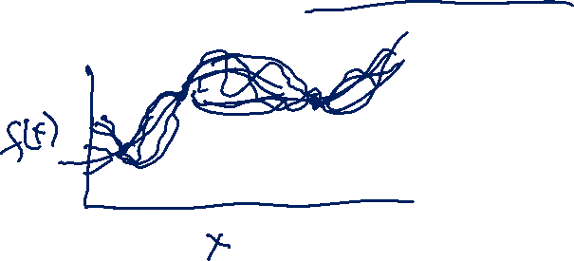
Probabilistic Surrogate Models
It is often useful to quantify confidence in a surrogate model
One approach is to use a probabilistic model that quantifies our confidence
A common probabilistic model is the Gaussian process

Slide 13
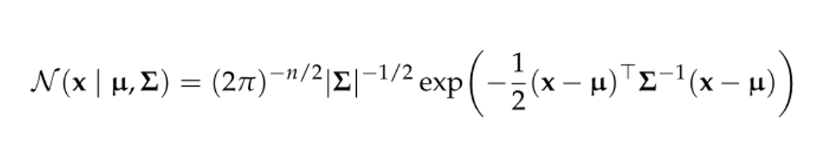
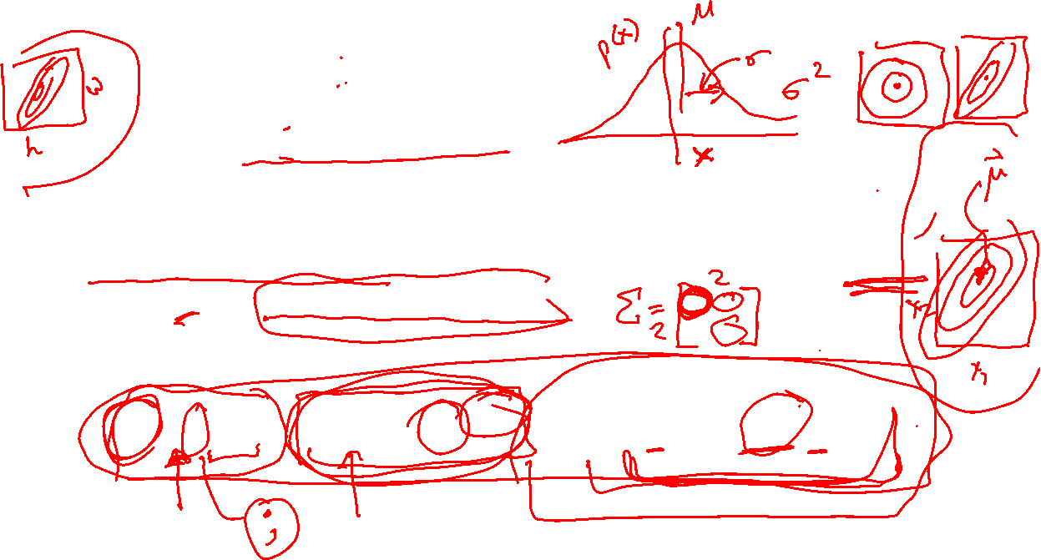
Gaussian Distribution
Also called normal distribution
Univariate Gaussian distribution is parameterized by mean µ and variance σ²
Multivariate Gaussian distribution is parameterized by mean vector µ and covariance matrix ∑
Probability density at x is given by

Slide 14



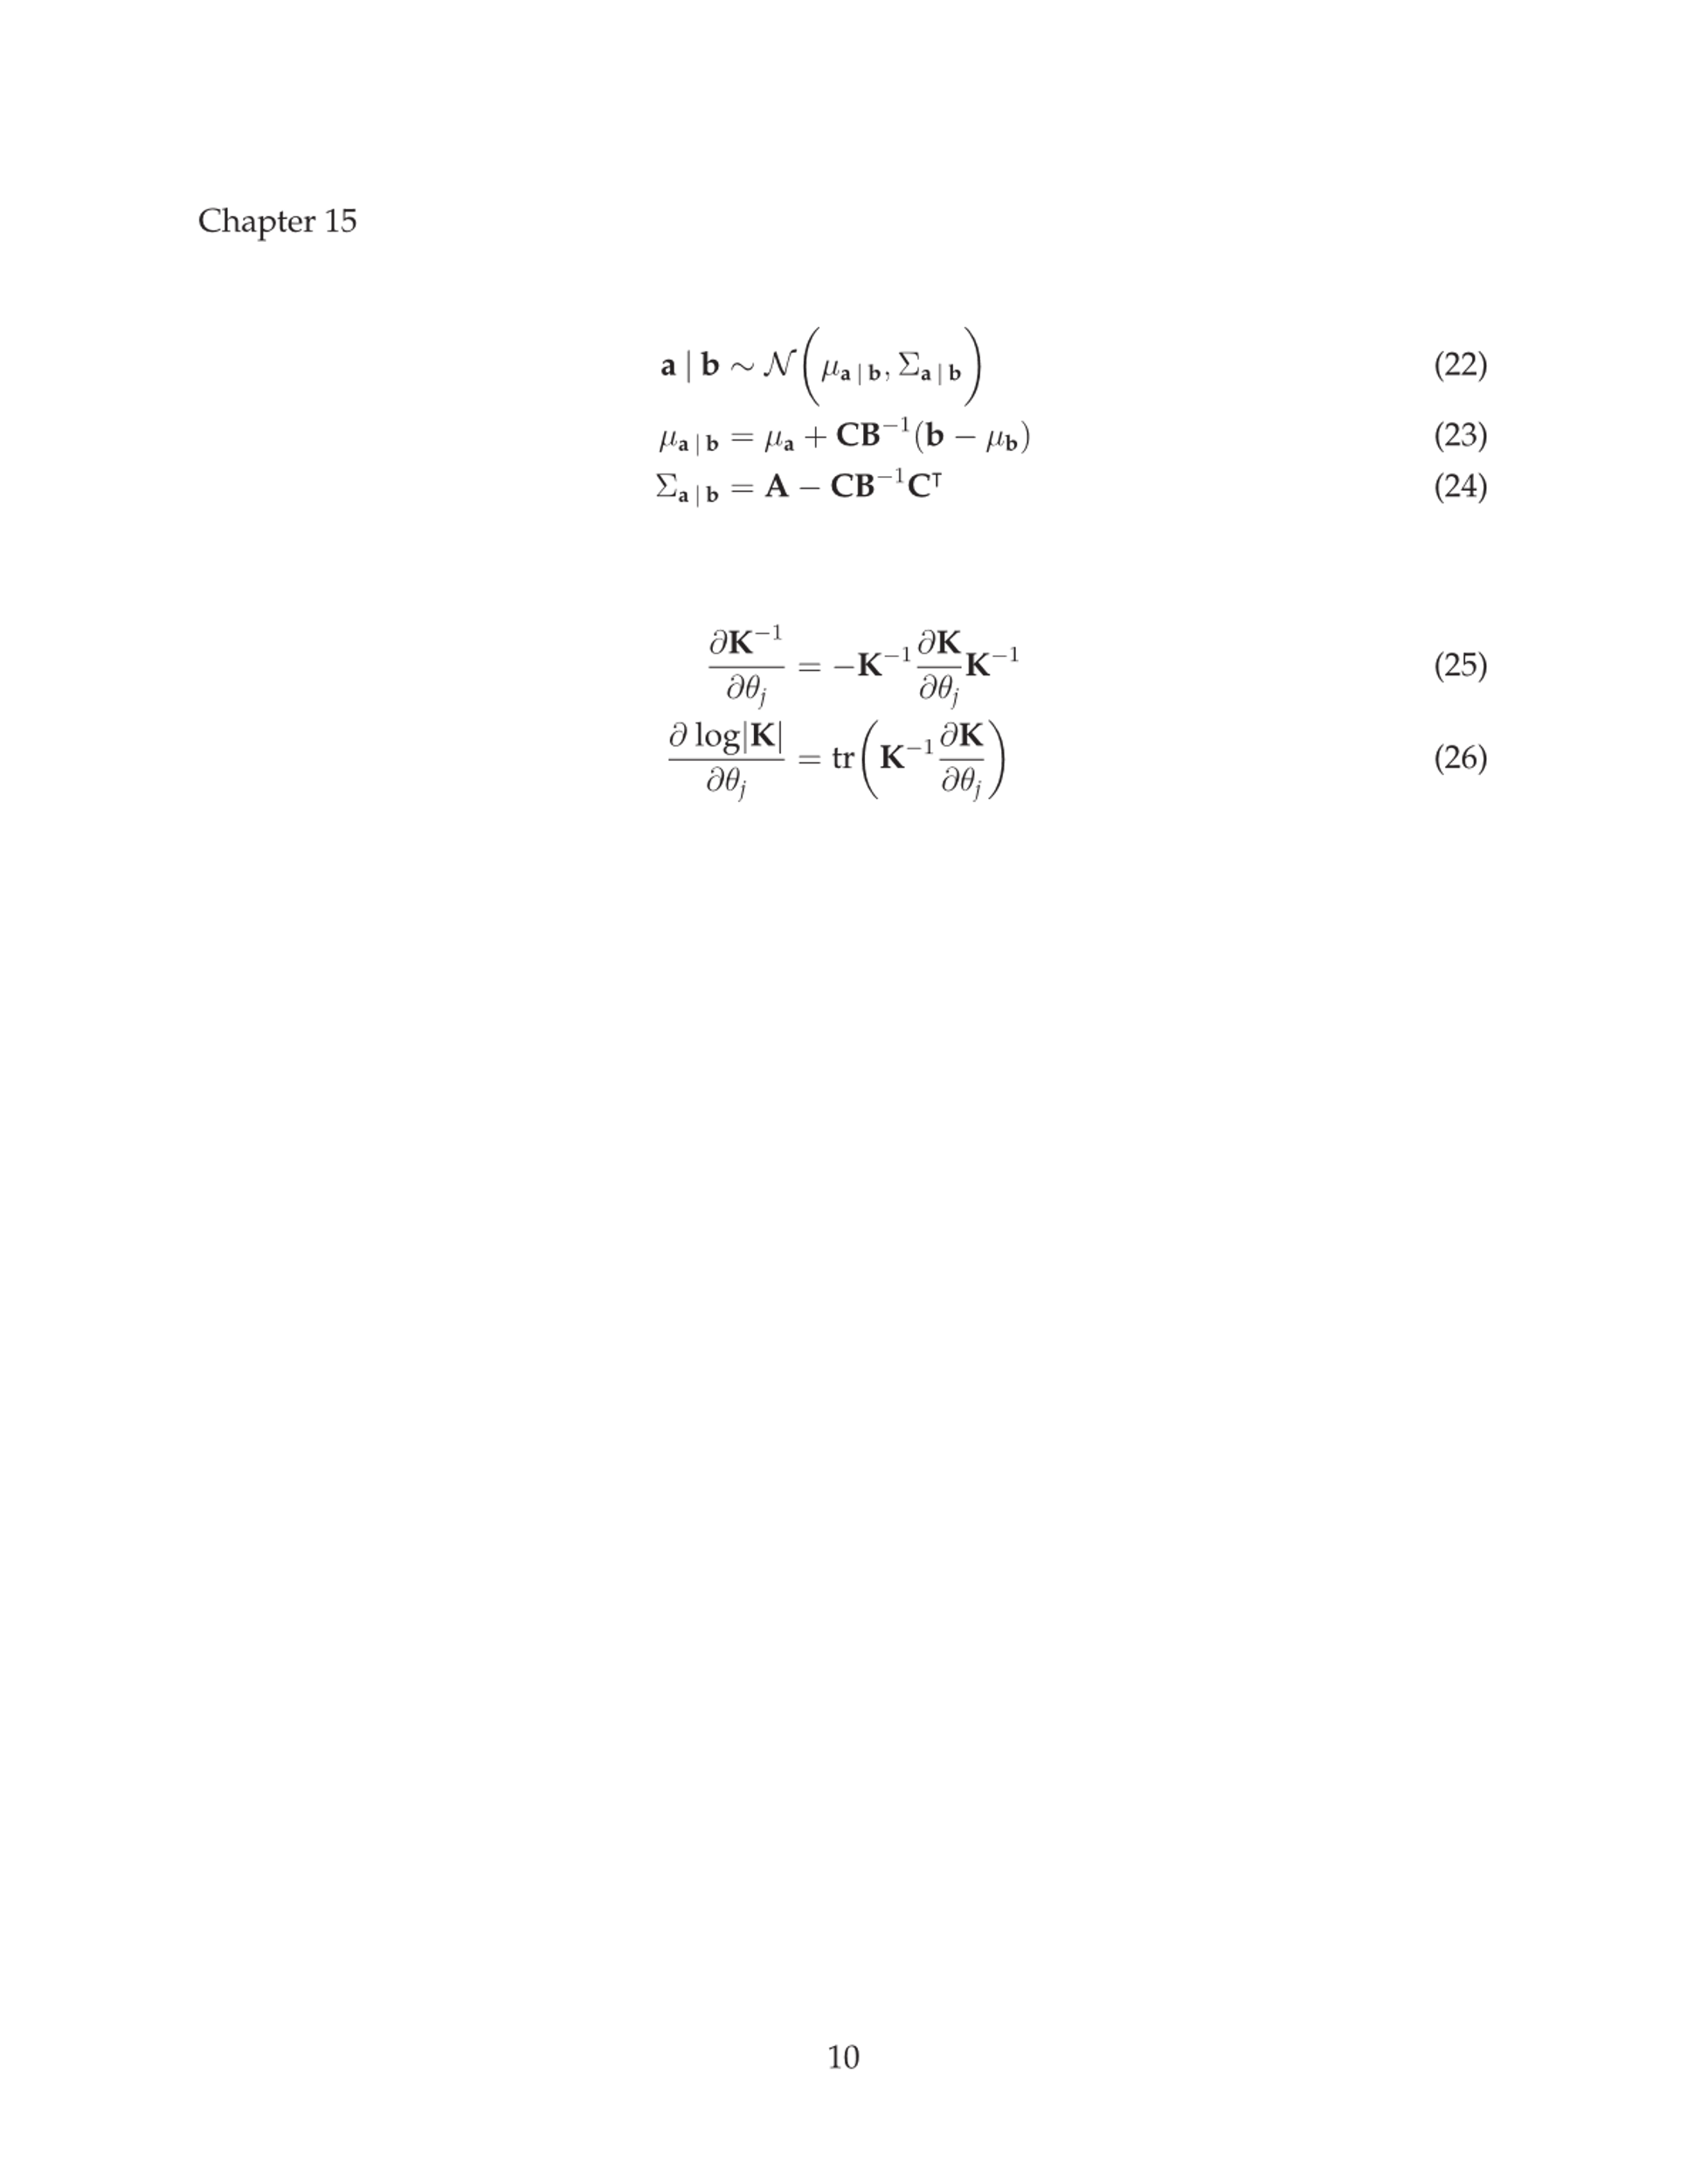
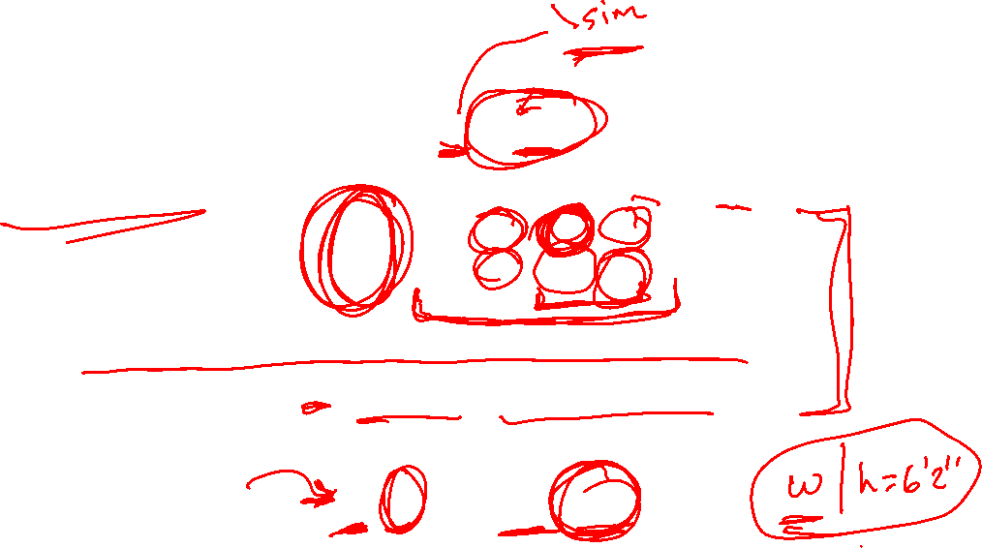
Gaussian Distribution
Sampling a value from a Gaussian is written as
Two jointly Gaussian random variables a and b are written as
Each variable’s marginal distribution is written as
A variable’s conditional distribution is written as

Slide 15
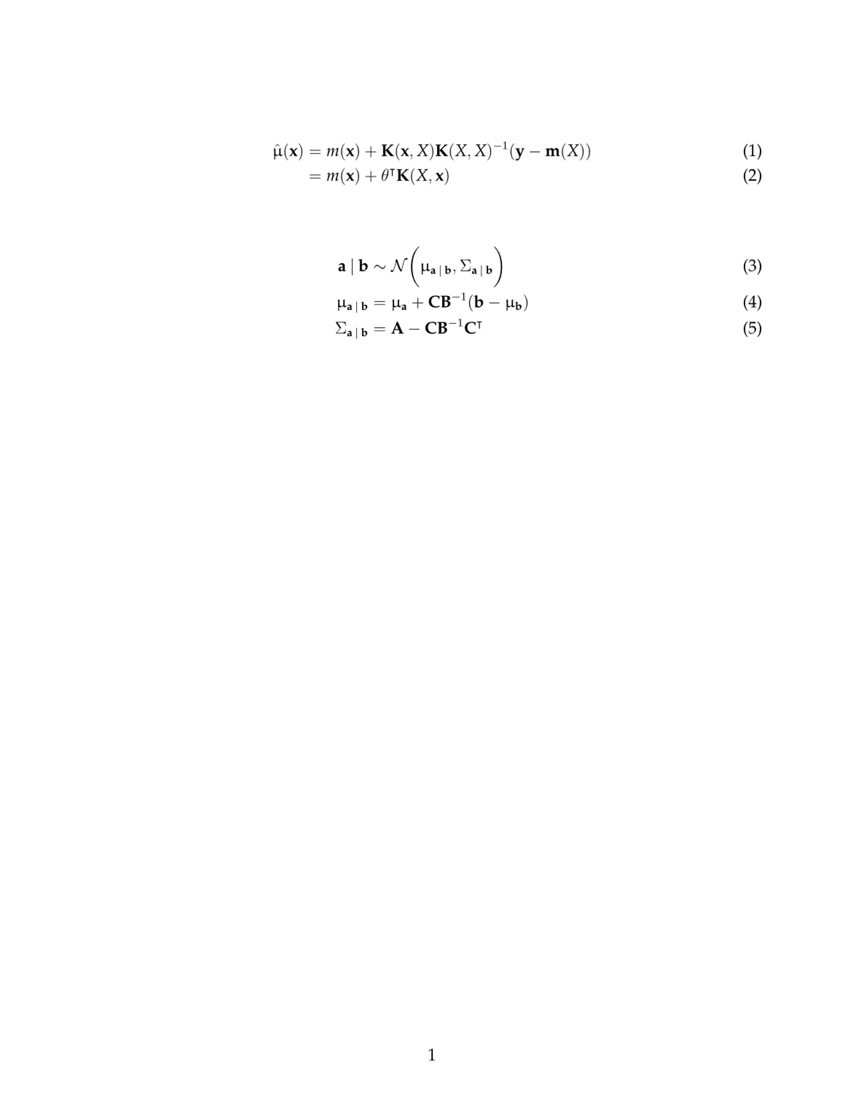
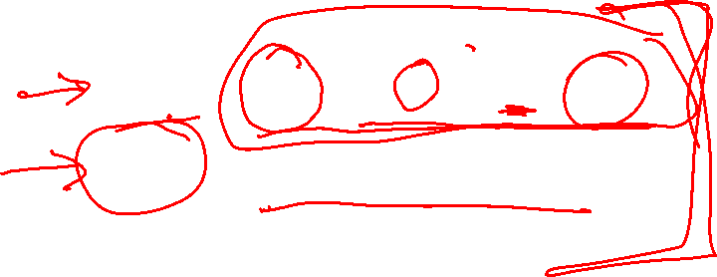
Gaussian Distribution
Given the full set of parameters µ and ∑, the parameters for conditional distributions can be easily computed

Slide 16
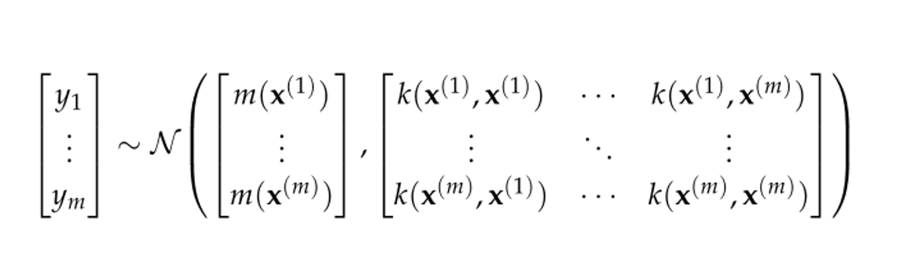
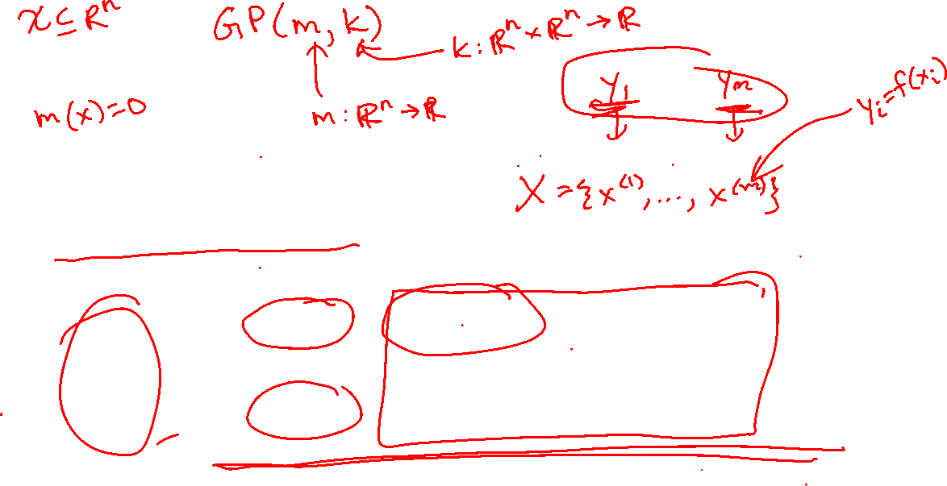
Gaussian Processes
A Gaussian Process extends the idea of Gaussian distributions to functions
For any finite set of points, the distribution over the function evaluations at those points is written as
Here, m(x) is the mean function and k(x, x’) is the covariance function or kernel

Slide 17

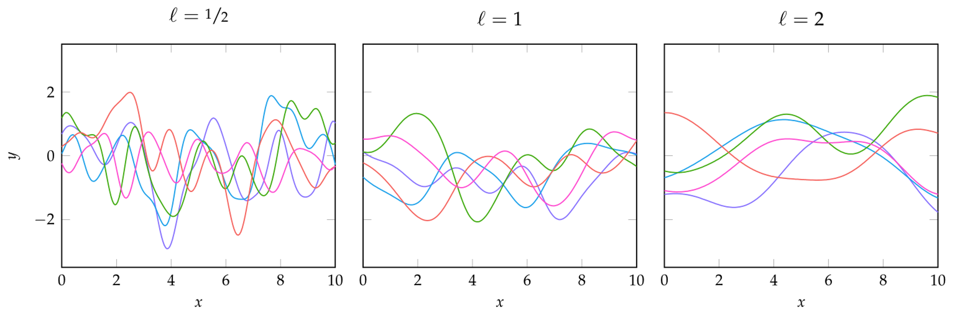
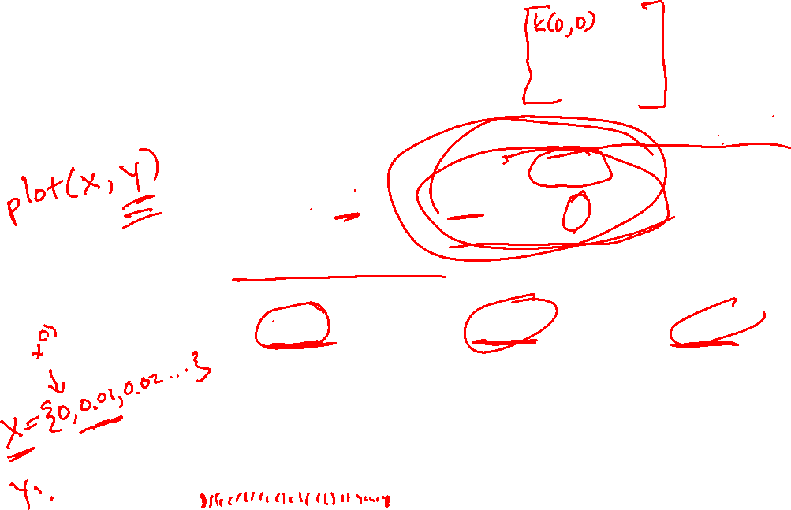
Gaussian Processes
A common kernel function is the squared exponential kernel
where ℓ is the characteristic length-scale, which is the distance required for the function to change significantly

Slide 18
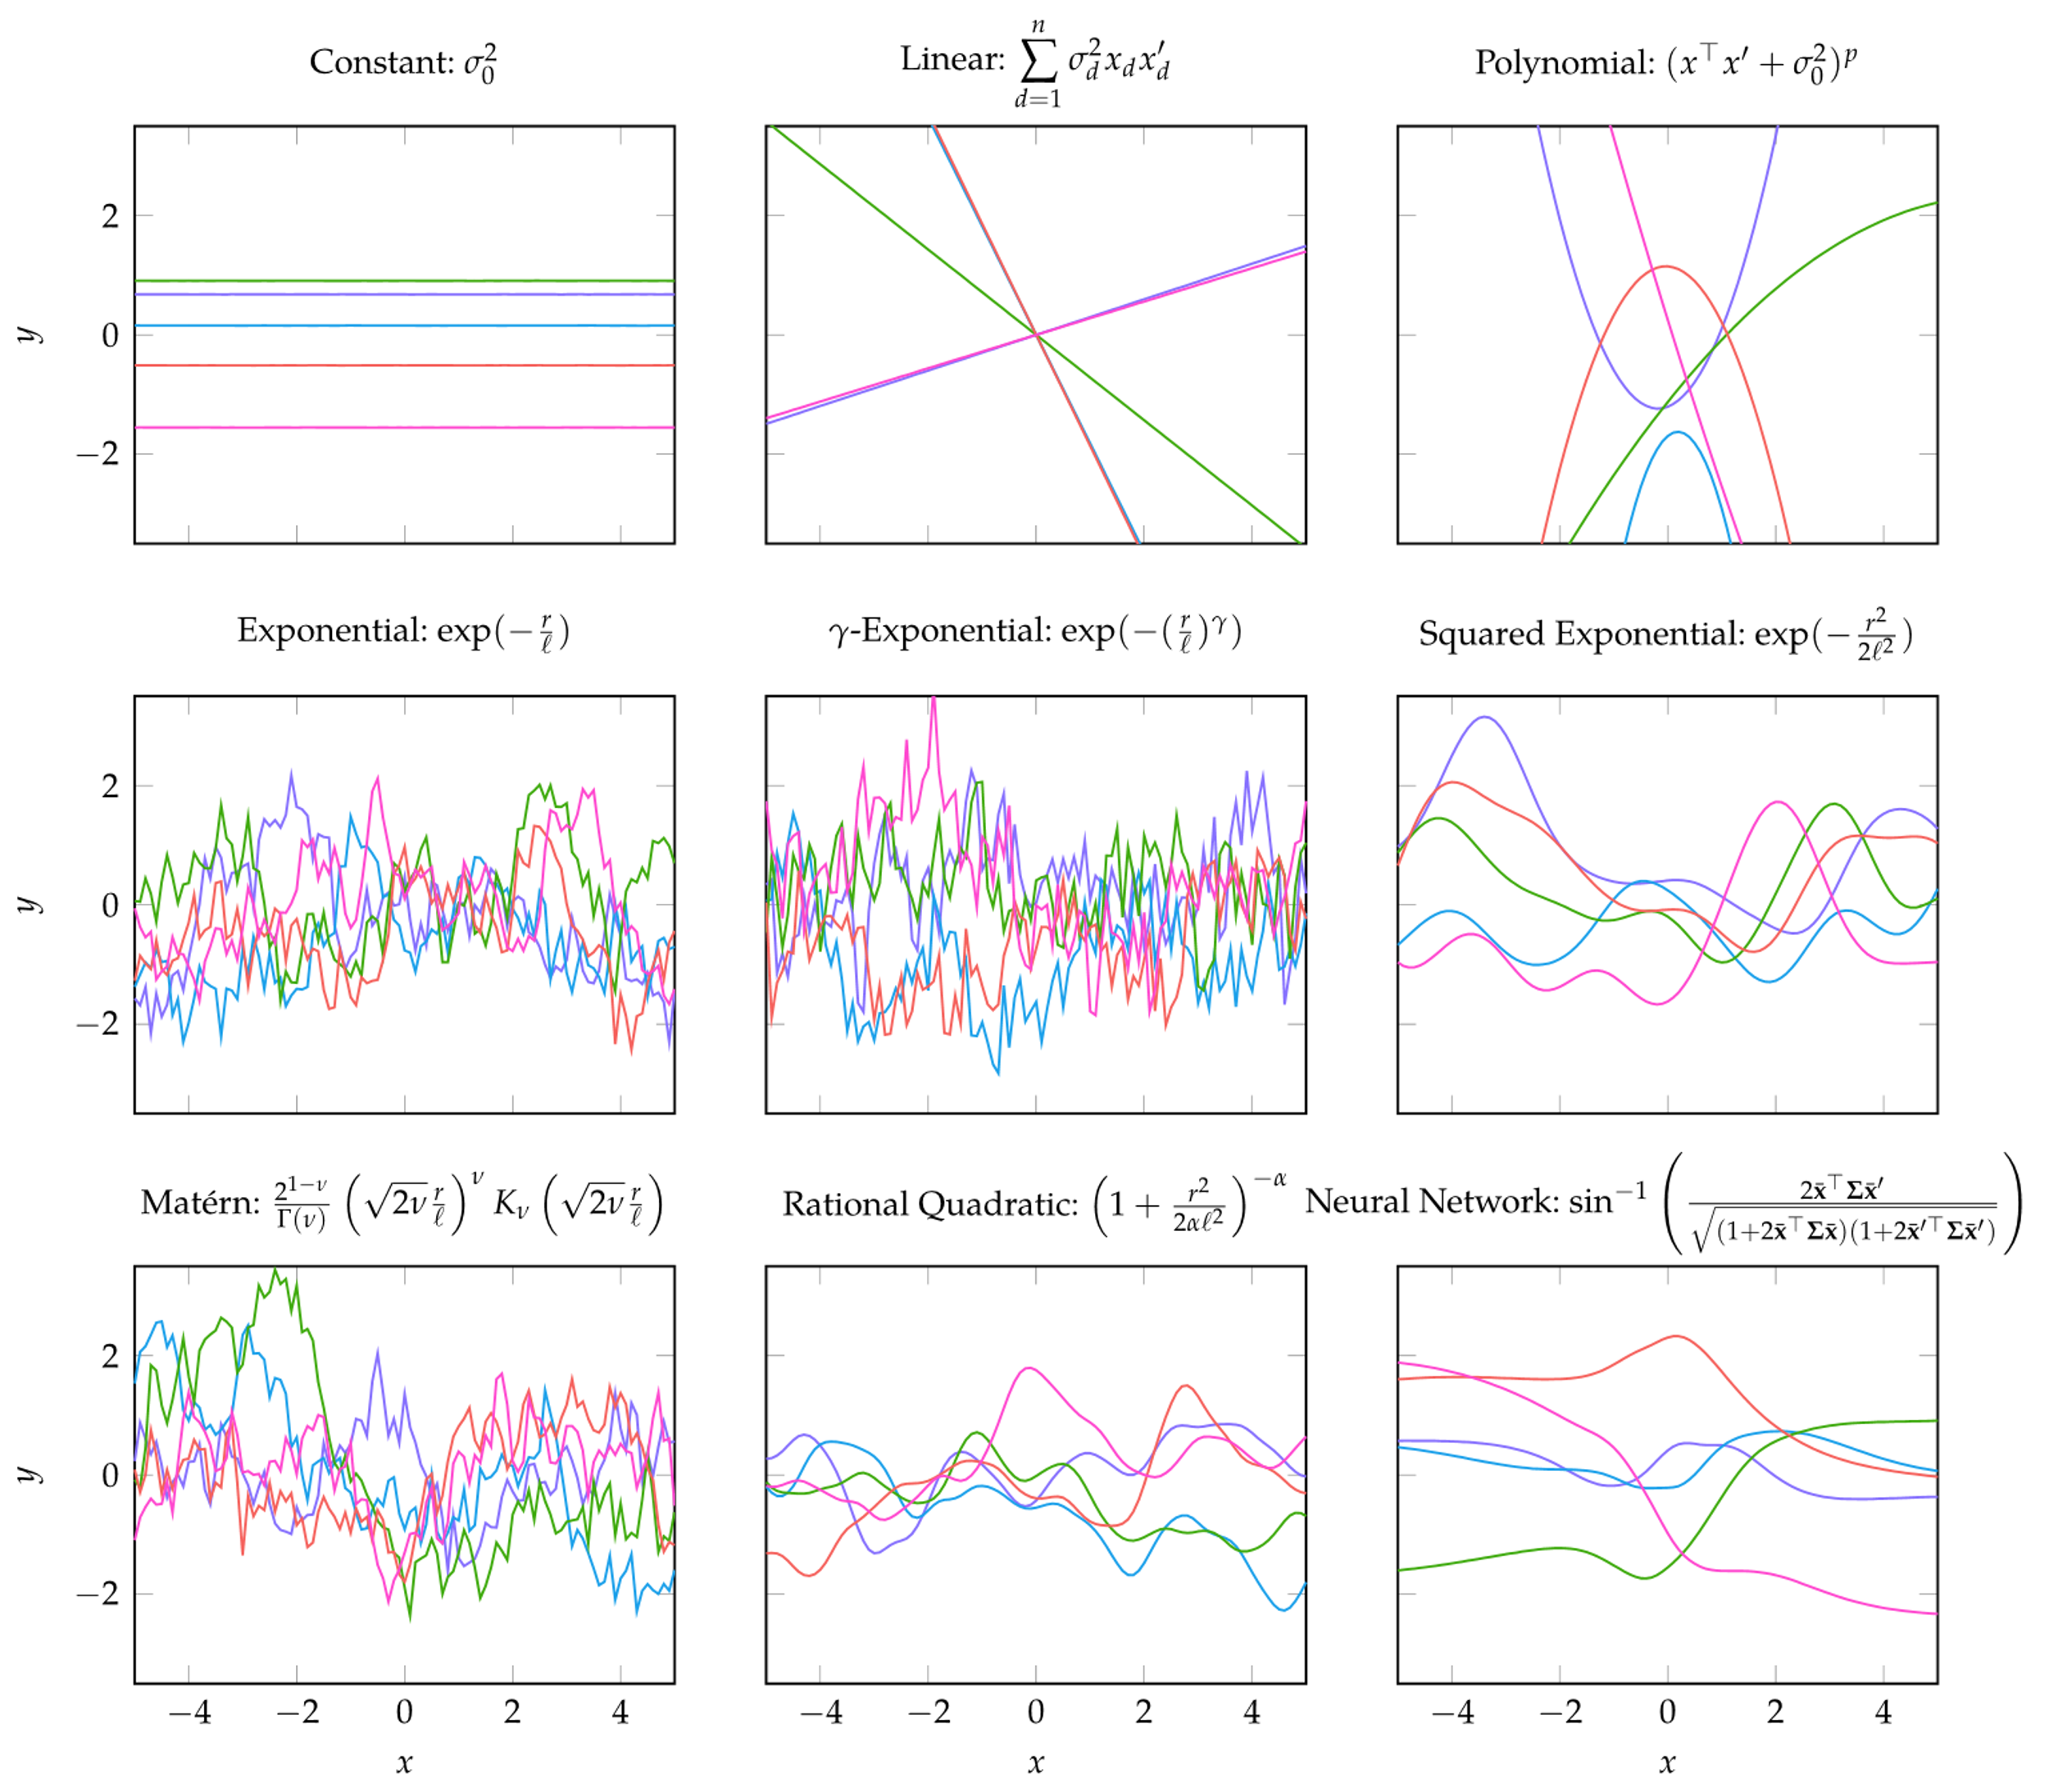

Gaussian Processes
Examples of the same Gaussian process with different kernel functions

Slide 19
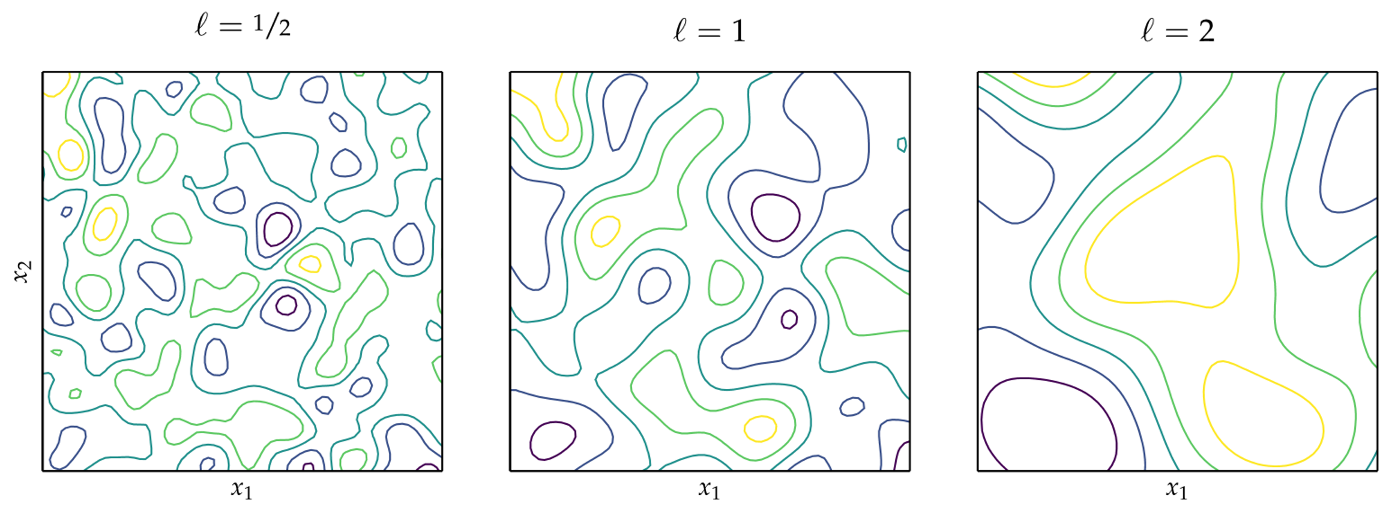

Gaussian Processes
Example of multivariate Gaussian with squared-exponential kernel at different length scales

Slide 20

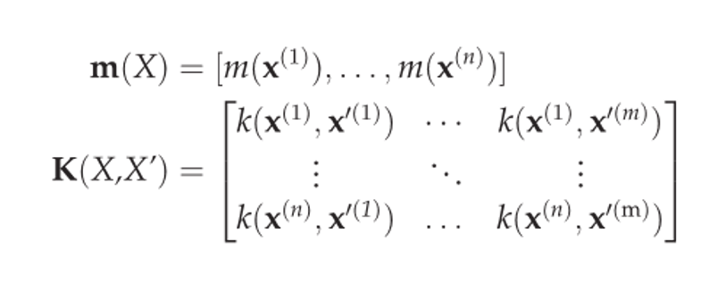
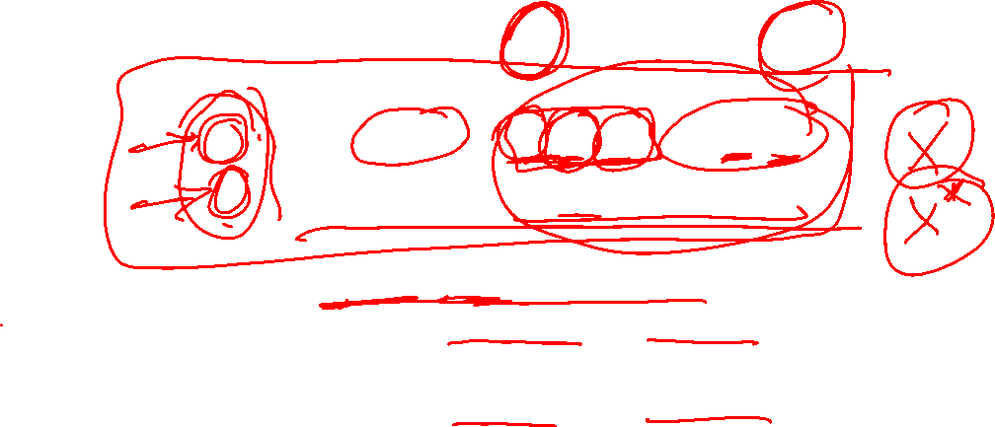
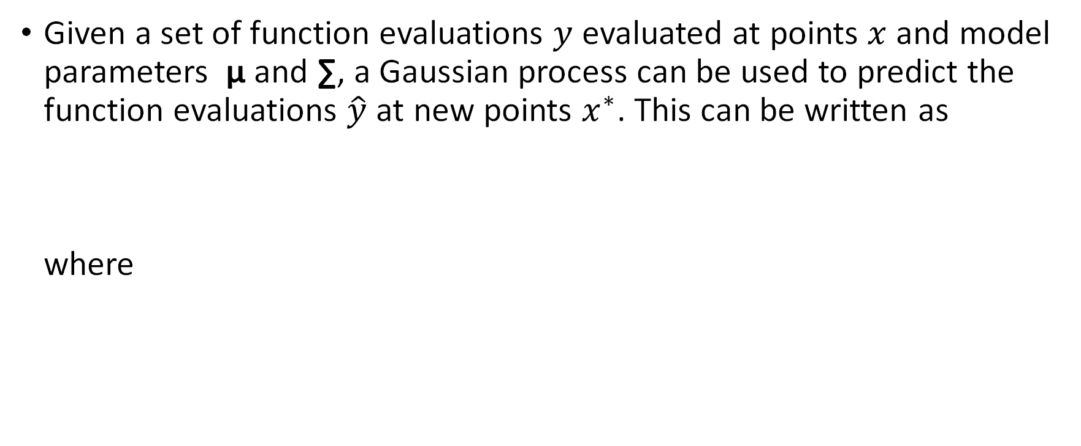
Prediction
Given a set of function evaluations $y$ evaluated at points $x$ and model parameters µ and ∑, a Gaussian process can be used to predict the function evaluations $\hat{y}$ at new points $x^{∗}$. This can be written as where

Slide 21
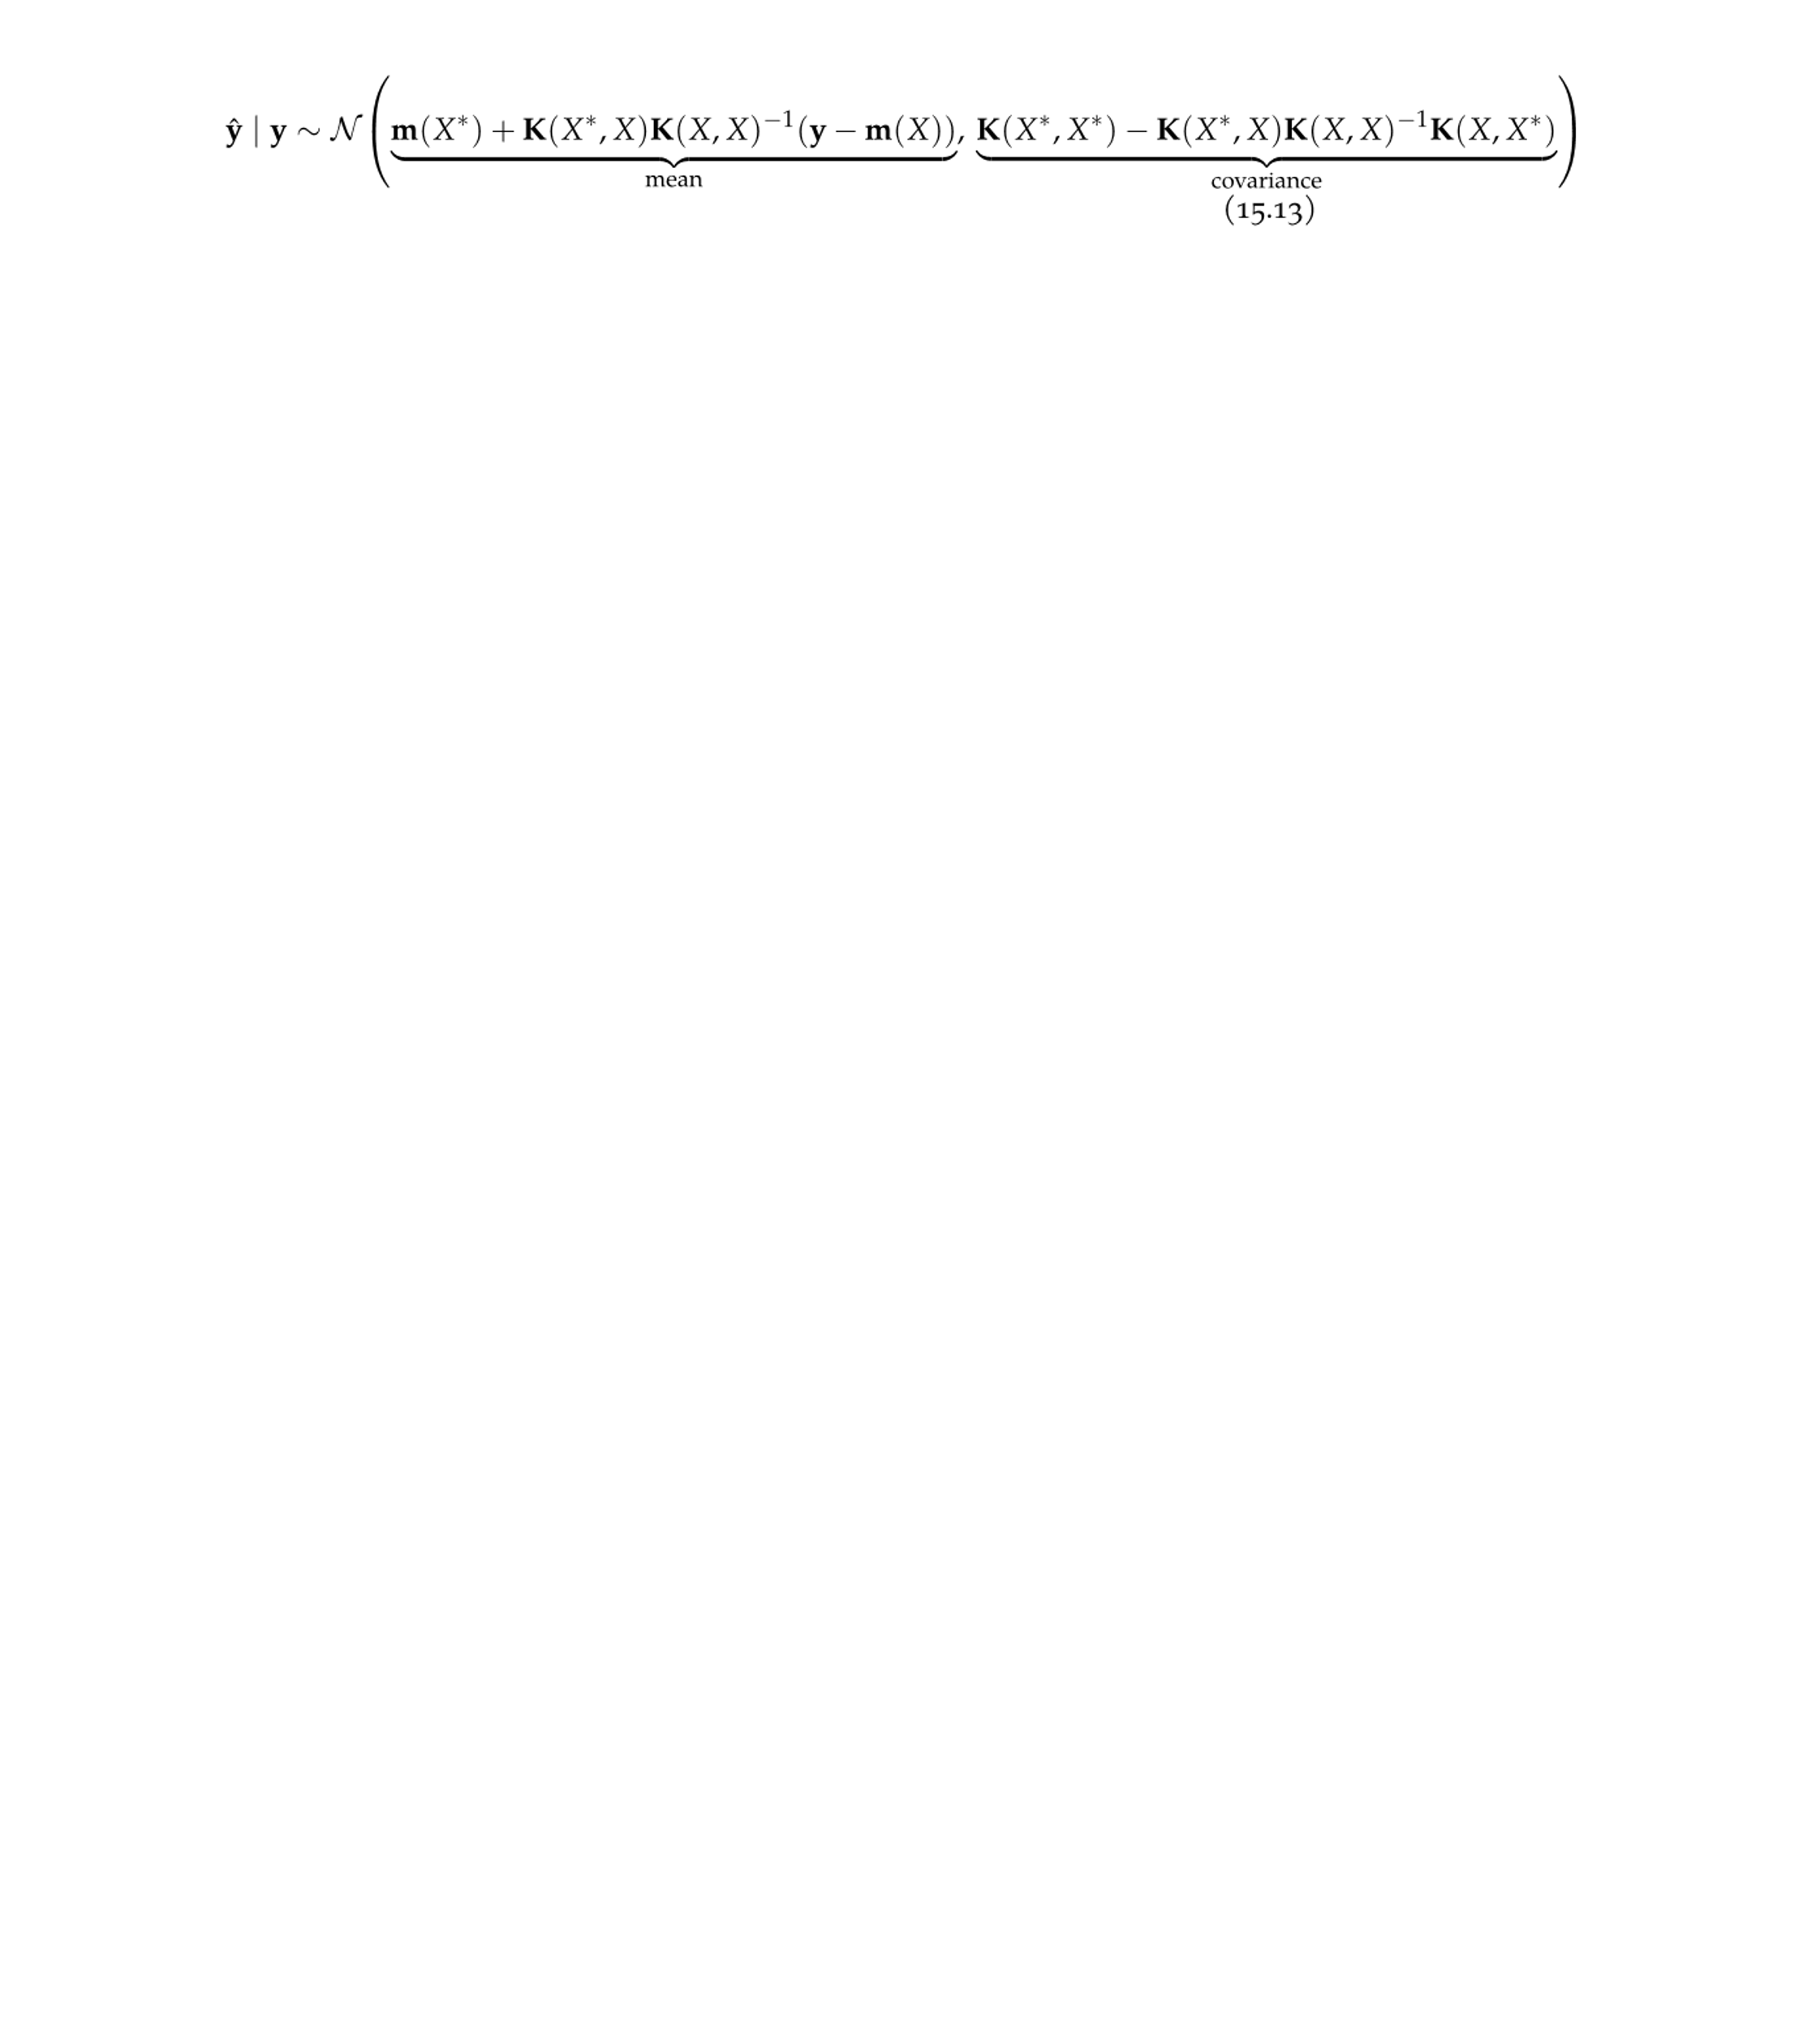

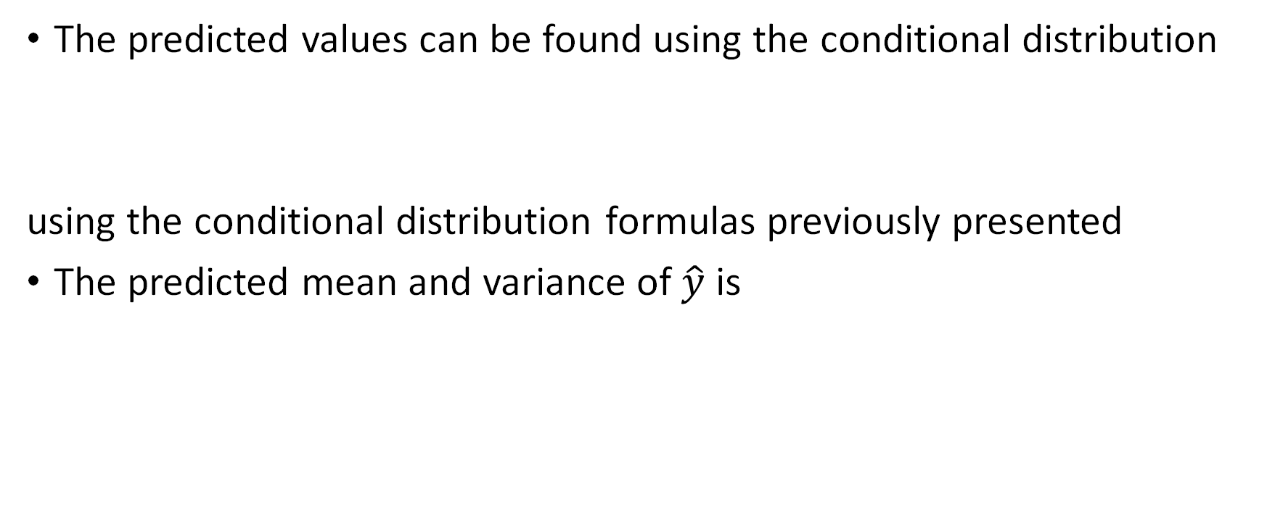
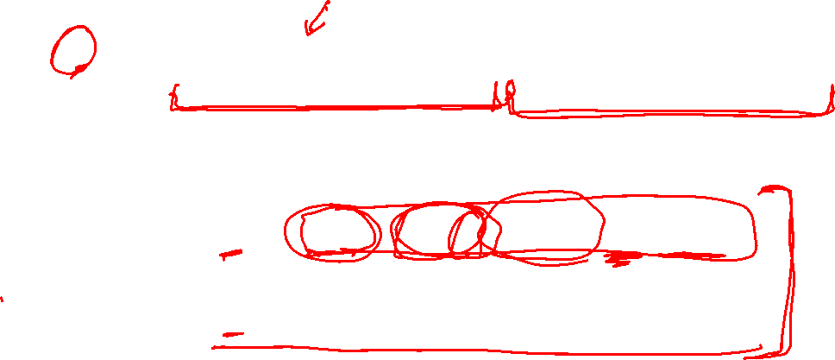
Prediction
The predicted values can be found using the conditional distribution
using the conditional distribution formulas previously presented
The predicted mean and variance of $\hat{y}$ is

Slide 22
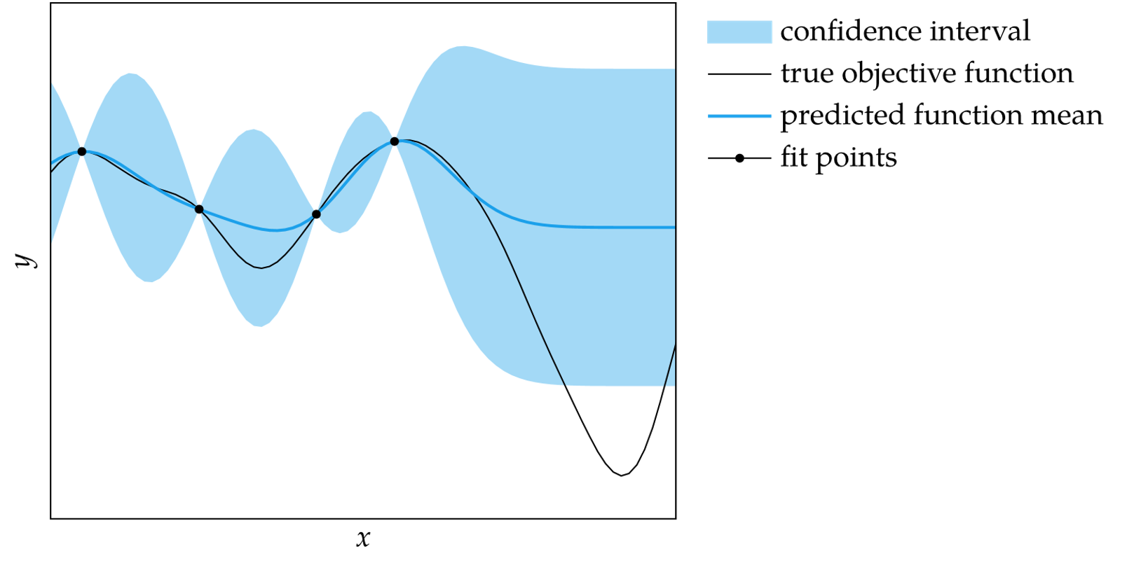
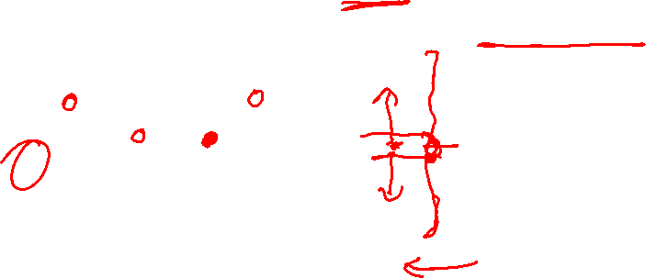
Prediction
Using variance to compute standard deviation, the predicted mean and standard deviation can be computed at any point
This enables calculation of the 95% confidence region

Slide 23
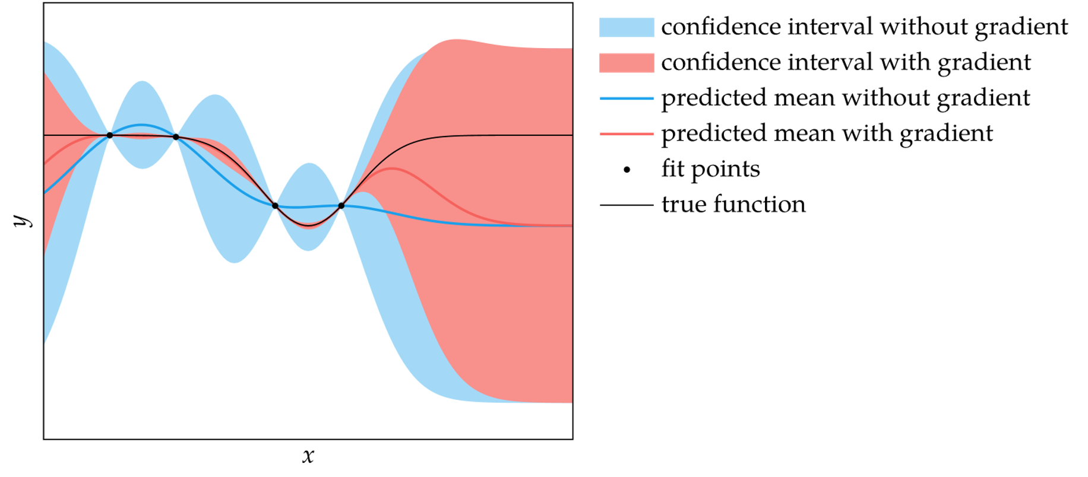

Gradient Measurements
If function gradient evaluations can be made as well, the process can be extended to include gradient predictions for higher prediction fidelity

Slide 24
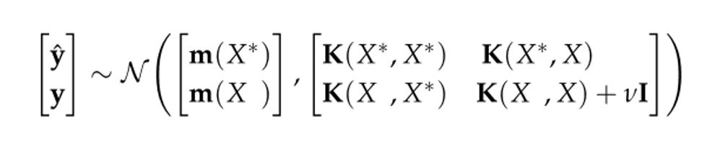


Noisy Measurements
If function evaluations are affected by zero-mean noise, then the joint distribution can be augmented and solved the same way

Slide 25
Fitting Gaussian Processes
The choice of kernel and parameters can be found using cross validation methods
Instead of minimizing squared error, we maximize the likelihood of the data
To avoid working with numbers of greatly disparate orders of magnitude, the log-likelihood is maximized in practice

Slide 26
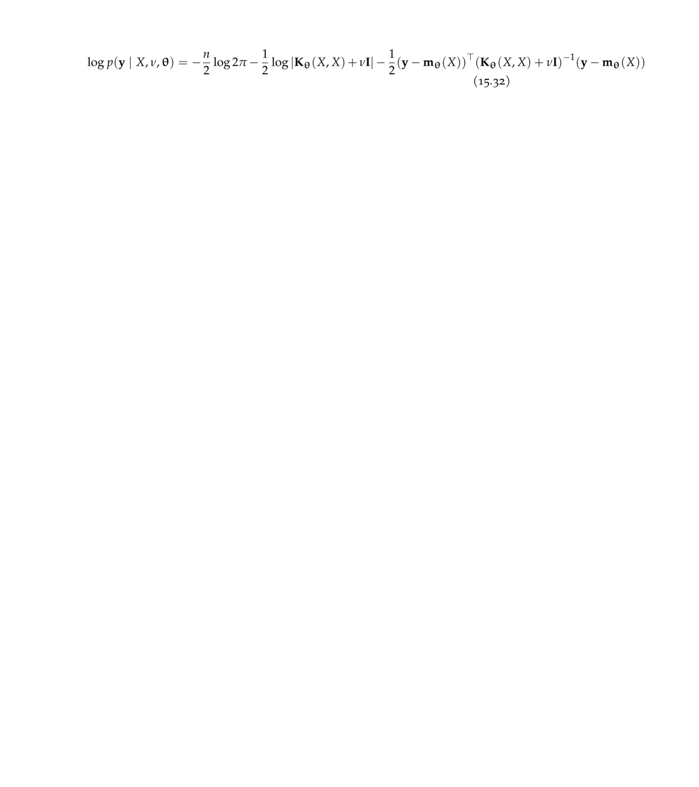
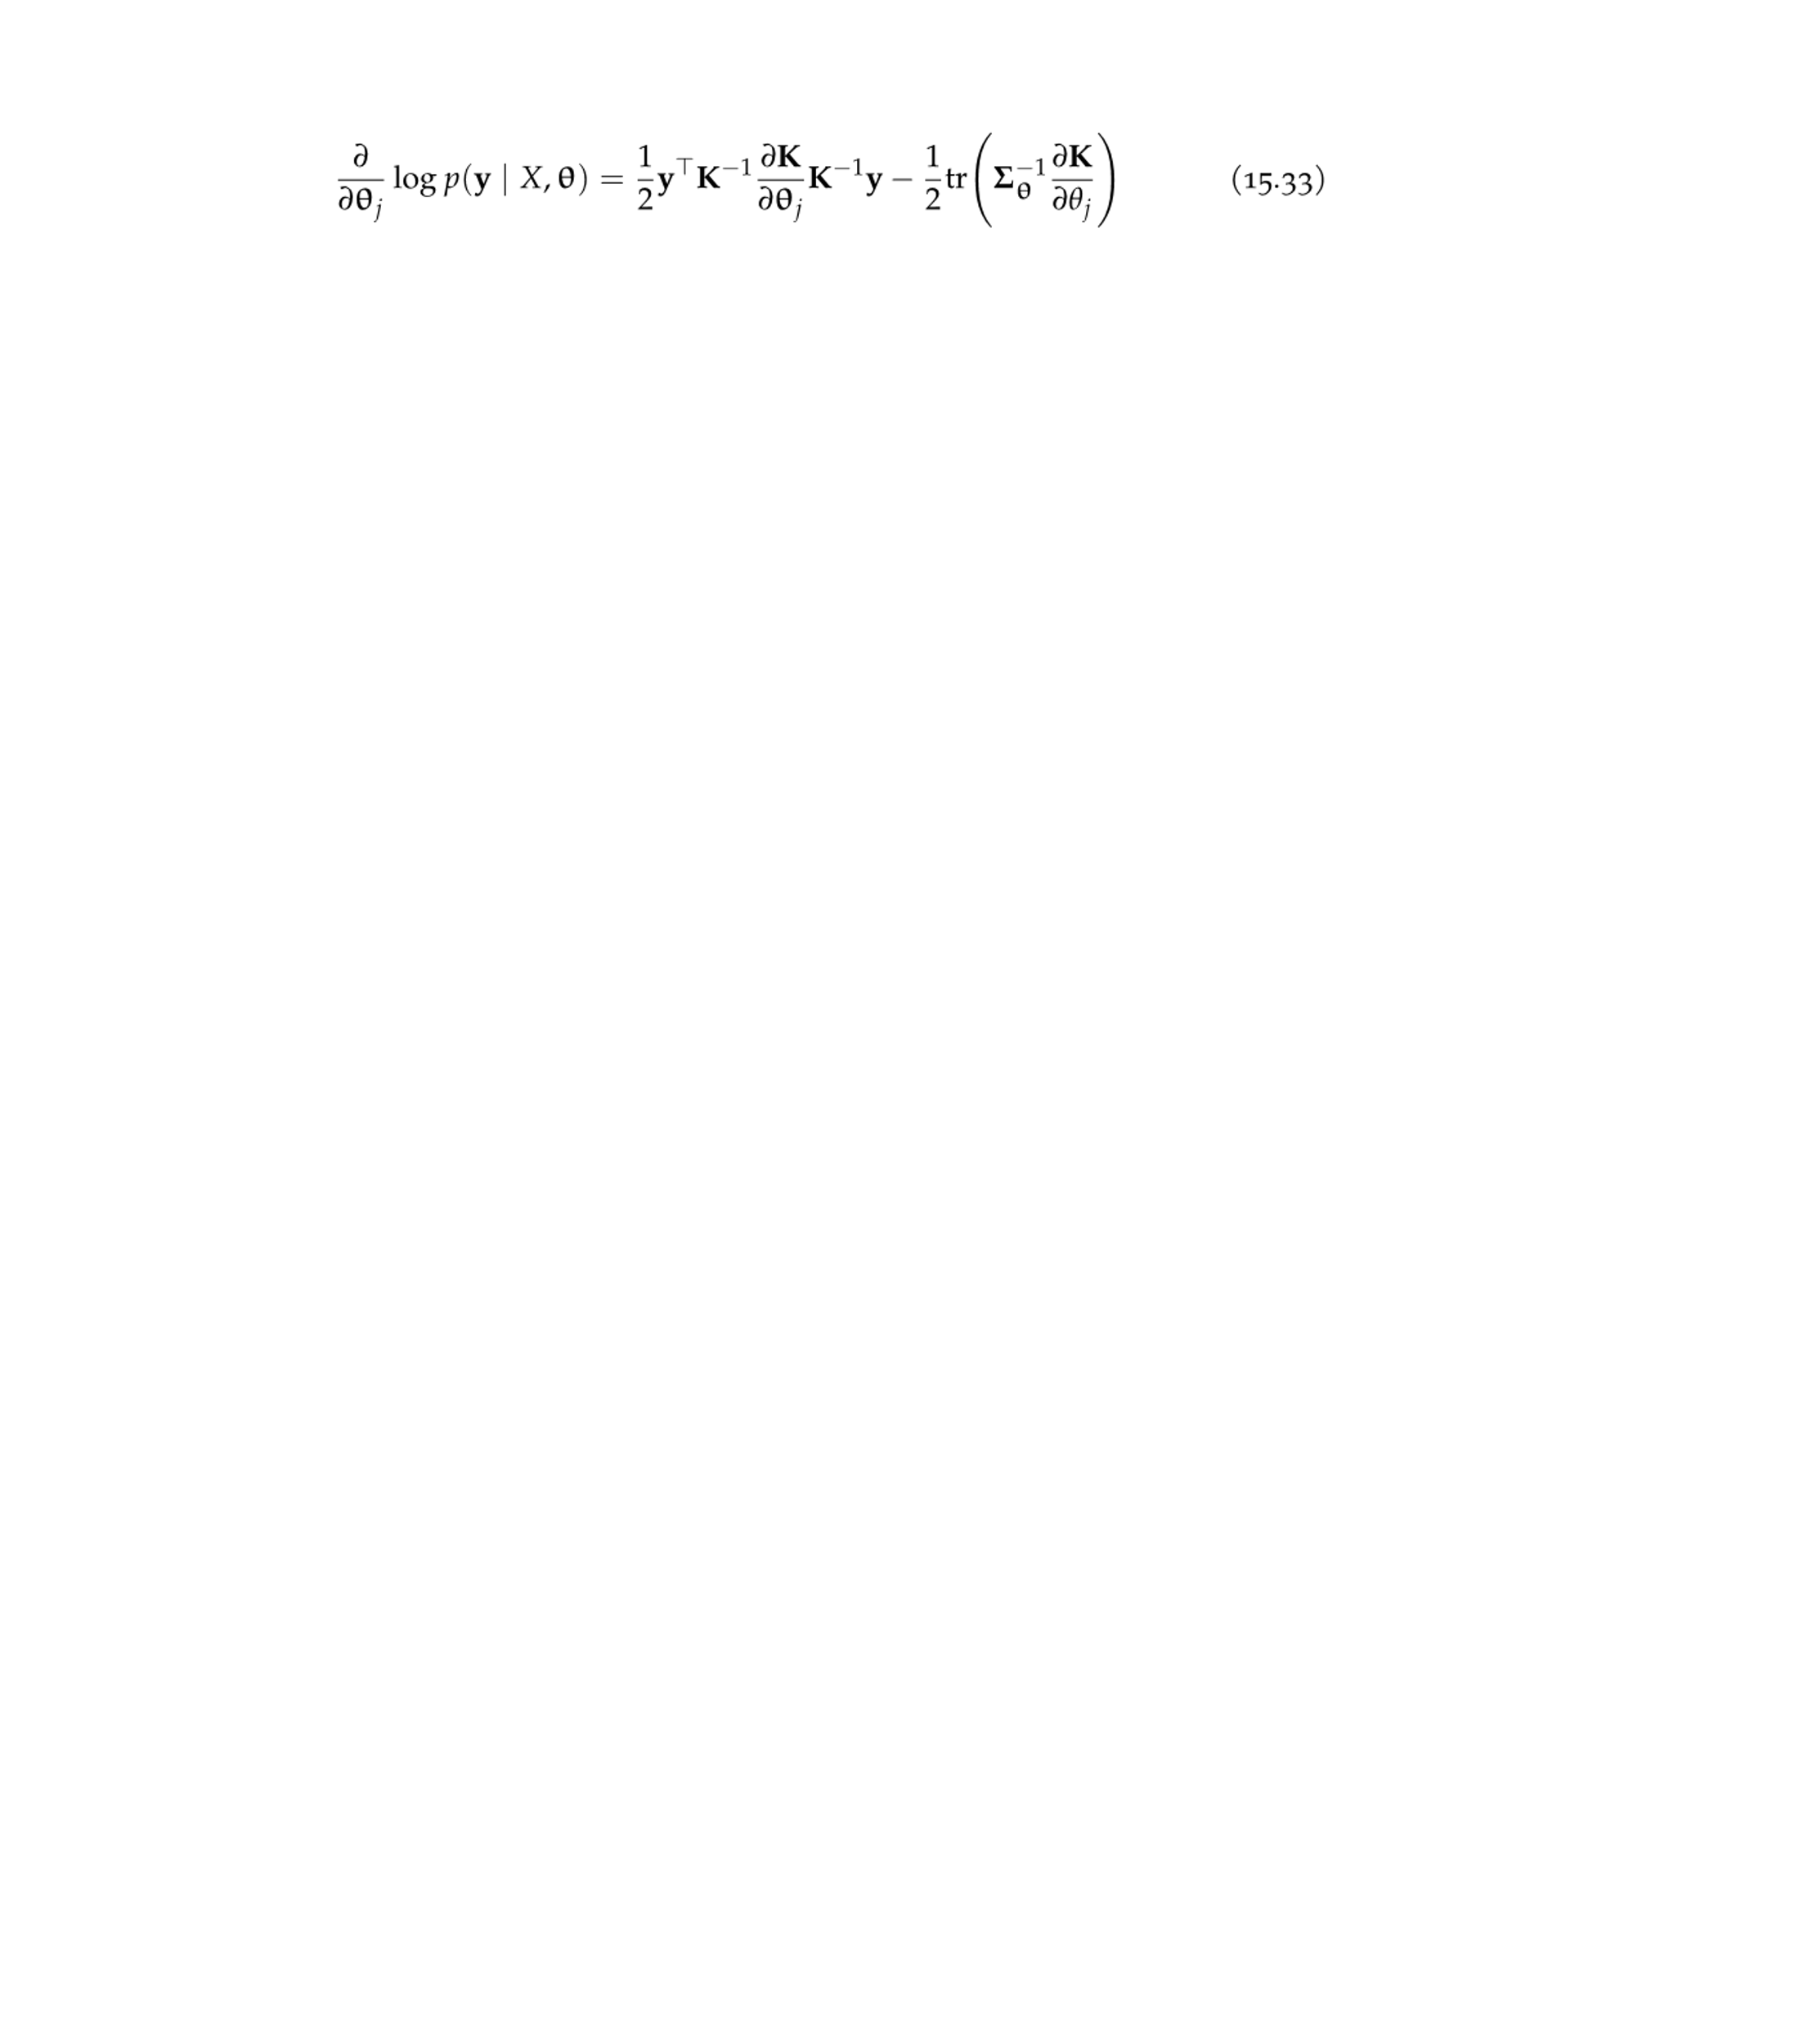

Fitting Gaussian Processes
The log-likelihood formula for a Gaussian process with zero-mean noise
Can be maximized using gradient ascent
Gradient formula for log-likelihood is
where

Slide 27
Summary
Gaussian processes are probability distributions over functions
The choice of kernel affects the smoothness of the functions sampled from a Gaussian process
The multivariate normal distribution has analytic conditional and marginal distributions
We can compute the mean and standard deviation of our prediction of an objective function at a particular design point given a set of past evaluations

Slide 28
Summary
We can incorporate gradient observations to improve our predictions of the objective value and its gradient
We can incorporate measurement noise into a Gaussian process
We can fit the parameters of a Gaussian process using maximum likelihood

